Slide 1
Topic: Measurement EQ: How do I calculate land dimensions for a set area?
Year 11 Essentials

Slide 2
Things Required For This Lesson
Interactive Notebook
Textbook: Interleaved Maths Essential Connections
Ruler, Red Pen, Pencil, Pens, Scientific Calculator
Growth mindset

Slide 3
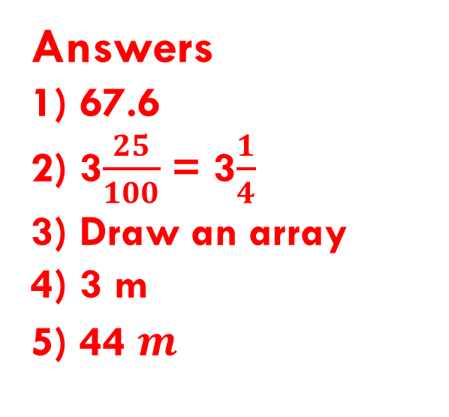
First 5
Answers
1) 67.6
2) 3$\frac{25}{100}$ = 3$\frac{1}{4}$
3) Draw an array
4) 3 m
5) 44 $m^{}$
71.2 – 3.6
Write 3.25 as a fraction
How do you know for sure that 6 x 8 = 48? Demonstrate a way that you could prove it, without using a calculator or other technology?
I have 12 meters of fabric to us to make 4 curtains. I plan to use the leftover fabric to make some cushion for my bedroom. Each curtain requires 2.25 meters of fabric. How much fabric will I have left for my cushions?
Find the are for a triangle with a base of 11m and height of 8m.

Slide 4
24
7
30
Topic: Measurement
EQ: How do I calculate land dimensions for a set area?
Discuss – Think Pair Share
Discuss the relative cost of buying a block of land
What would be the easiest way to compare costs?
WICOR
Notes:
Easiest way to compare costs is to calculate the cost per metre

Slide 5
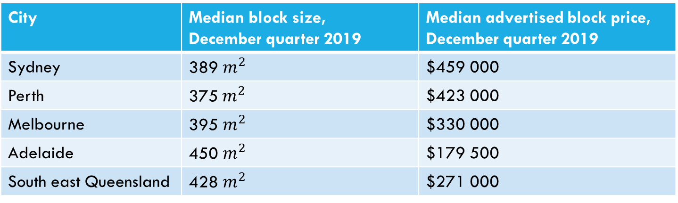
24
7
30
Topic: Measurement
EQ: How do I calculate land dimensions for a set area?
Experiment
The table below shows the median block size and advertised price for 5 Australian locations in December 2019 from the UDIA State of the Land survey. Assuming that each block has a minimum street frontage of 8m, draw scaled diagrams to show possible dimensions for each block.
City | Median block size, December quarter 2019 | Median advertised block price, December quarter 2019
Sydney | 389 $m^{2}$ | $459 000
Perth | 375${ m}^{2}$ | $423 000
Melbourne | 395 $m^{2}$ | $330 000
Adelaide | 450 $m^{2}$ | $179 500
South east Queensland | 428 $m^{2}$ | $271 000
WICOR
Notes:
Graph paper
Important for year 12 to draw scaled diagrams

Slide 6
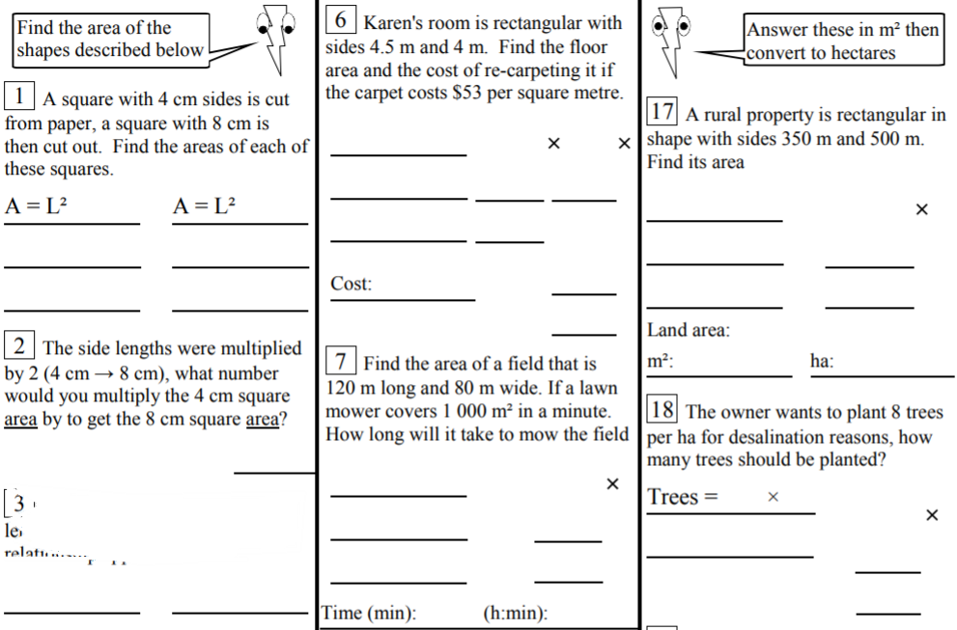
Complete Application questions on page 70
Finished? Have a go at these:

Slide 7

Thank you
Keep up the good work!

